Slide 1
Loan Risk Analysis
By Jacob Lloyd

Slide 2
What are we doing?
Data pulled from Lending Club
Loan values 0 or 1 (bad or good)
Predict future loans using model

Slide 3
Our Data
Our data was compiled by Deep Anshu (Github: deepanshu88)
Originally from Lending Club’s publicly available data
Provides much information on the applicant
Year of birth, children/dependents, income, home value, other debt, etc.

Slide 4
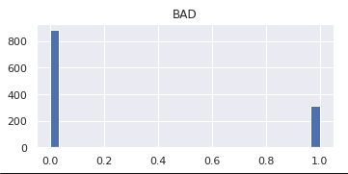
Total Outcomes

Slide 5
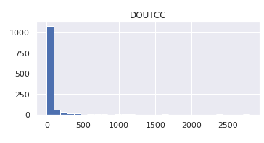
Outstanding Credit Card Debt

Slide 6
Evaluation/Application/Recommendation
5 Model Iterations Tested Overall
Logistic Regression (Base & L1 + L2 Hypertuned)
Decision Tree Model (Base & GridSearchCV Hypertuned)
Base Decision Tree Model
Best for industry model

